Slide 1

AIR RESISTANCE
We will explain air resistance using familiar objects

Slide 2
Match the word/phrase with the definition:
Contact force A. Force resisting movement when objects touch
Friction B. Push, pull or twist
Force C. Force between objects with touching
Non-contact force D. Force between objects without touching

Slide 3
Repeat the opposite word/phrase.
FORCE
PUSH, PULL OR TWIST

Slide 4
Repeat the opposite word/phrase.
SPRING BALANCE
MEASURES FORCES

Slide 5
Repeat the opposite word/phrase.
INDEPENDENT VARIABLE
WHAT WE CHANGE IN AN EXPERIMENT

Slide 6
Repeat the opposite word/phrase.
DEPENDENT VARIABLE
WHAT WE MEASURE IN AN EXPERIMENT

Slide 7
Repeat the opposite word/phrase.
CONTROLLED VARIABLE
WHAT WE KEEP THE SAME IN AN EXPERIMENT

Slide 8
Repeat the opposite word/phrase.
NEWTON
UNIT OF FORCE

Slide 9
Repeat the opposite word/phrase.
BALANCED FORCE
EQUAL IN OPPOSITE DIRECTIONS

Slide 10
Repeat the opposite word/phrase.
UNBALANCED FORCE
UNEQUAL FORCES

Slide 11
Repeat the opposite word/phrase.
CONTACT FORCES
PHYSICAL CONTACT

Slide 12
Repeat the opposite word/phrase.
NON-CONTACT FORCES
NO PHYSICAL CONTACT

Slide 13
Repeat the opposite word/phrase.
FRICTION
RESISTING FORCE DURING CONTACT

Slide 14

Calculate the net force from the diagram below.
10N
20N

Slide 15
Calculate the net force from the diagram below.
12N
20N

Slide 16
Calculate the net force from the diagram below.
50N
75N

Slide 17
Complete the table below on your whiteboard.
Force | Contact Force | Non-Contact Force
Mechanical Pushing
Magnetic
Friction
Gravity

Slide 18
We will explain₁ air resistance using familiar₂ objects
TRACK WITH ME
READ WITH ME
We will define air resistance
We will use examples to explain how air resistance affects other forces
DEFINITION
1 - describe 2 - well-known
DECLARE THE OBJECTIVE
Read the learning objective to your partner.

Slide 19
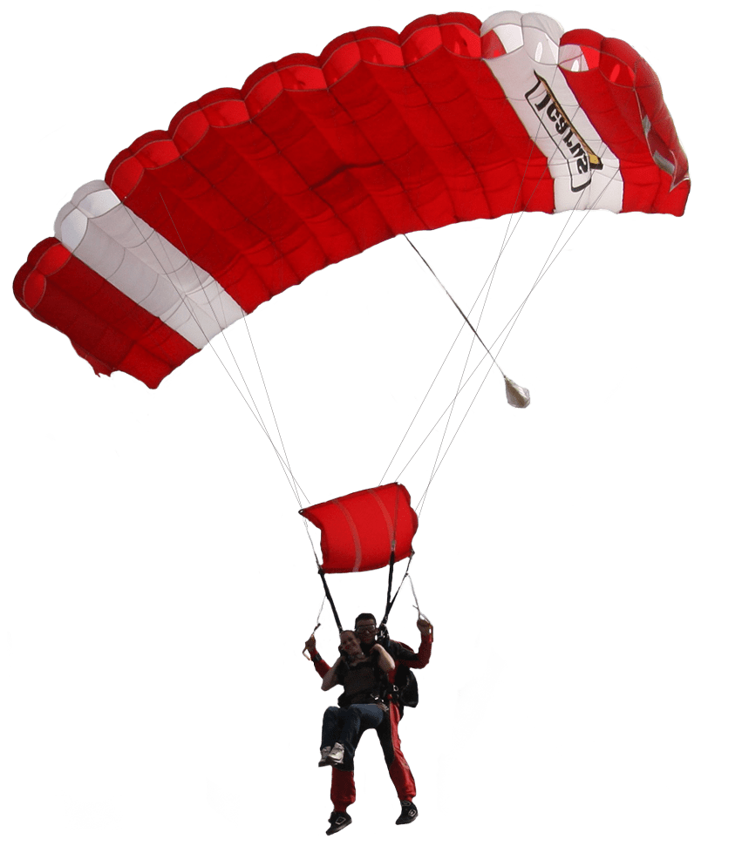
We will explain air resistance using familiar objects
Friction is the force that resists movement between two objects that are touching.
When an object moves through air it also touches the air particles.
A parachute is an object that touches the air particles as it falls, slowing the parachuter down as it touches more air.
Which force diagram (A or B) below do you think shows the parachuter?
MAKE THE CONNECTION
Students, you already know that forces occur when two objects interact. Have a think about how parachutes slow a skydivers fall?
A
B

Slide 20
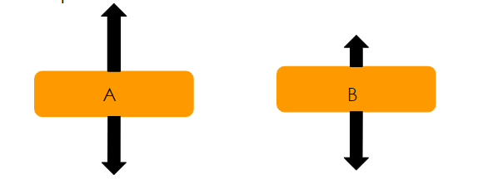
We will explain air resistance using familiar objects
CHECK FOR UNDERSTANDING
What is air resistance? Is the air resistance arrow A or B ?
Air resistance is the force that resists₁ movement of an object passing through air particles₂.
Air resistance is opposite the pull force of gravity and objects moving forward.
The larger the air resistance acting on an object the longer the arrow.
A
B
VOCABULARY
1 - stops or slows 2 -parts of matter

Slide 21
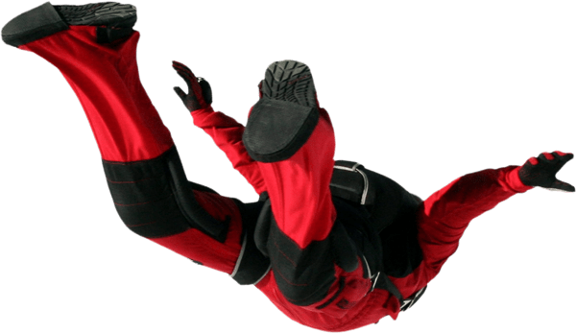
We will explain air resistance using familiar objects
CHECK FOR UNDERSTANDING
Looking at the diagram below, what object increases air resistance? What happens to the net force as the parachuter B falls to Earth?
Air resistance is the force that resists₁ movement of an object passing through air particles₂.
Air resistance reduces the net force by increasing the opposite force to gravity.
A larger surface area increase air resistance.
342N
150N
B
VOCABULARY
1 - stops or slows 2 -parts of matter
782N
A
782N

Slide 22
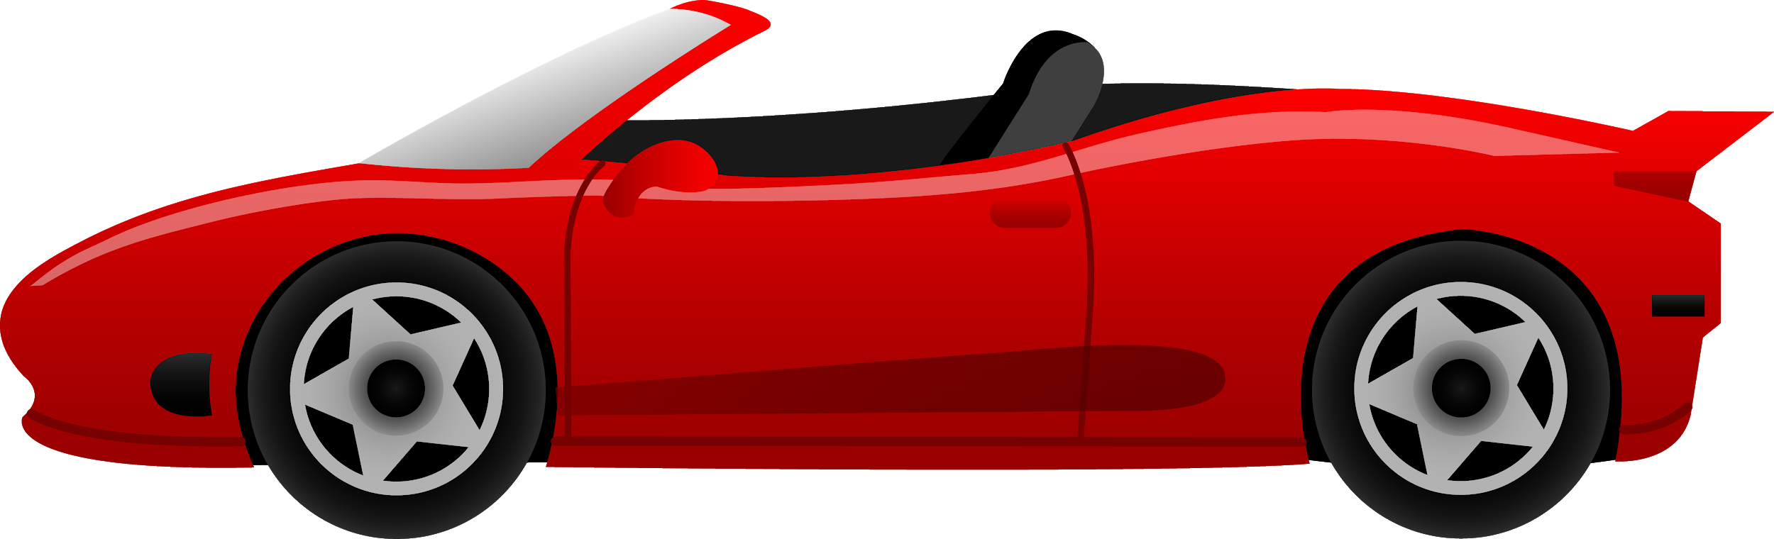
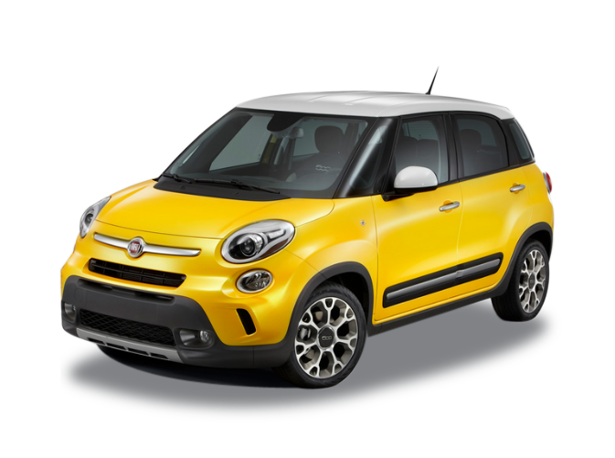
We will explain air resistance using familiar objects
CHECK FOR UNDERSTANDING
Looking at the diagram below, which arrows shows air resistance? What car has less air resistance? Explain your answer.
Objects moving forward through air particles have air resistance pushing it in the opposite direction.
A larger surface area increase air the force of resistance.
B
A
Examples: | Non-Examples:
Walking into a strong wind and air resistances pushing you back. A car driving forward and the air moving across the bonnet and top. A slimline jet moving through the sky. | A bag being dragged along the ground. Twisting the lid off of a jar of pickles. An athlete swimming in a race.
B
A
VOCABULARY
1 - stops or slows 2 -parts of matter

Slide 23
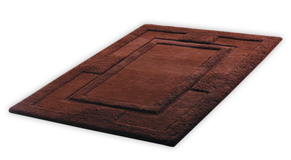
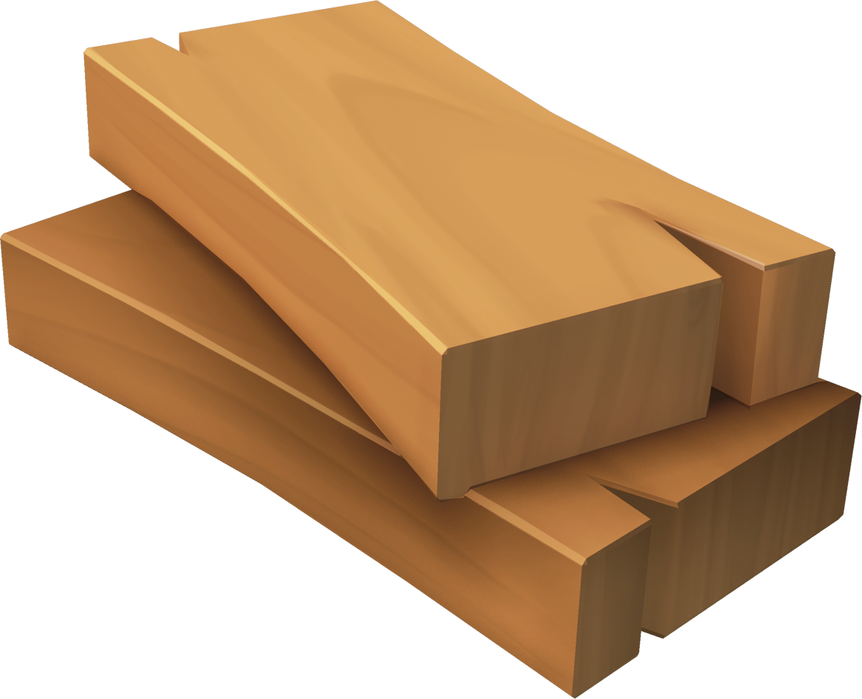
We will explain air resistance using familiar objects
CHECK FOR UNDERSTANDING
Give 1 example of air resistance. Why is a block being dragged along carpet not an example of air resistance?
Air resistance is the force that resists₁ movement of an object passing through air particles₂.
Air resistance is opposite the pull force of gravity and objects moving forward.
Examples: | Non-Examples:
A parachute slowing down a skydivers fall. Leaves falling slowly from a tree in Autumn. A cyclist riding into a heavy wind. | A block being dragged along carpet. Twisting the lid off of a jar of pickles. An athlete swimming in a race.
VOCABULARY
1 - stops or slows 2 -parts of matter

Slide 24
We will explain air resistance using familiar objects
CHECK FOR UNDERSTANDING
If air resistance is a bigger force, do objects slow down or speed up?
Describe how air resistance affects the examples below.
HINT
Students, remember…. Air resistance is the force that resists movement of an object passing through air particles. Air resistance reduces the net force by increasing the opposite force to gravity. A larger surface area increase air resistance. The larger the air resistance acting on an object the longer the arrow.
Example | How does air resistance affect:
A paper plane being thrown
A parachute being deployed
A person running

Slide 25


We will explain air resistance using familiar objects
Air resistance is the force that resists₁ movement of an object passing through air particles.
We sometimes increase air resistance to slow an objects fall, such as opening a parachute or having wings on a plane.
We can also reduce air resistance when we want something to stay moving or speed up, such as the aerodynamics of a plane.
CHECK FOR UNDERSTANDING
If you were designing a race car, would you want to increase or decrease air resistance?
DEFINITION
1 - stops or slows 2 - impacts

Slide 26
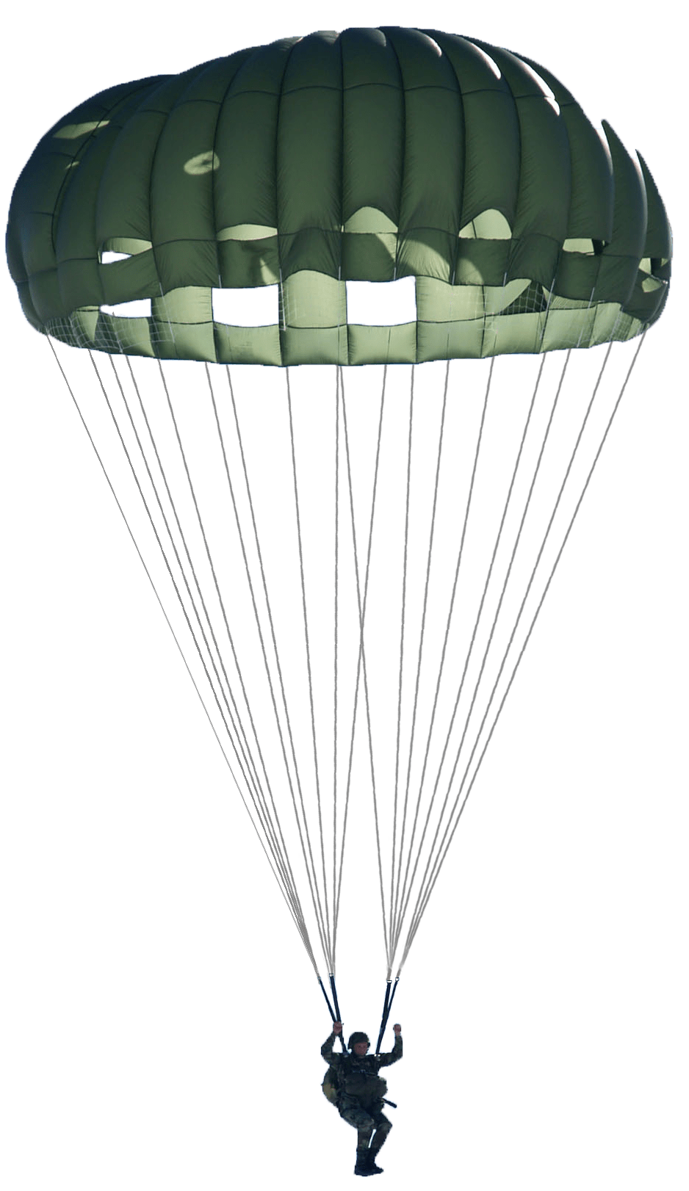
We will explain air resistance using familiar objects
CHECK FOR UNDERSTANDING
You are going skydiving and have chosen a parachute that has a larger surface area than the others. Below is a force diagram of you skydiving. Draw a force diagram of the other parachutes.
Air resistance is the force that resists₁ movement of an object passing through the air.
It is a contact force and affects every object which is surrounded by air.
Air resistance is present in objects moving through the air, and falling objects.
Air Resistance
Resistance
Gravity
Gravity
Air Resistance
Pushing force
DEFINITION
1 - stops or slows

Slide 27


We will explain air resistance using familiar objects
What is air resistance?
Is air resistance a contact or non-contact force? Explain your answer.
Which of the following would pass through the air with less air resistance? Explain your answer.
Where do we use air resistance to help speed up or slow down objects.
CHECK FOR UNDERSTANDING
Using an example, what is air resistance?
REMEMBER THE CONCEPT
Remember that air resistance is the force that resists movement when an object passes through the air.

Slide 28
We will explain₁ air resistance using familiar₂ objects
We will define air resistance
We will use examples to explain how air resistance affects other forces
DEFINITION
1 - describe 2 - well-known
CHECK FOR UNDERSTANDING
Check Success Criteria.

